Slide 1
How Can I Get More Information on VICH?
Bettye Walters, DVM
US Food and Drug Administration
Center for Veterinary Medicine
VICH Workshop: Dar Es Salaam, Tanzania – 24 June 2015

Slide 2
What will I find on the VICH website?
“the reference point for all past/current activities”
7 Major Headings
  HOME
  STRUCTURE
  PROCESS
  GUIDELINES
  CONSULTATIONS
  ACTIVITIES
  MEMBERS AREA

Slide 3
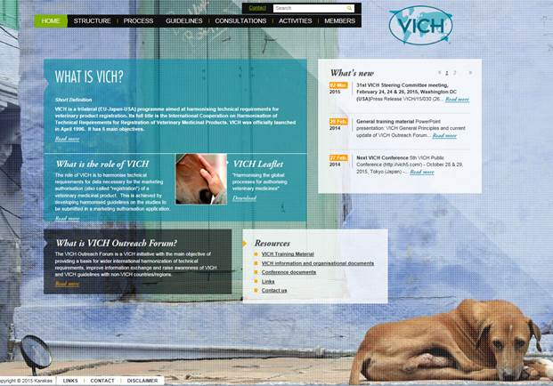
HOME

Slide 4
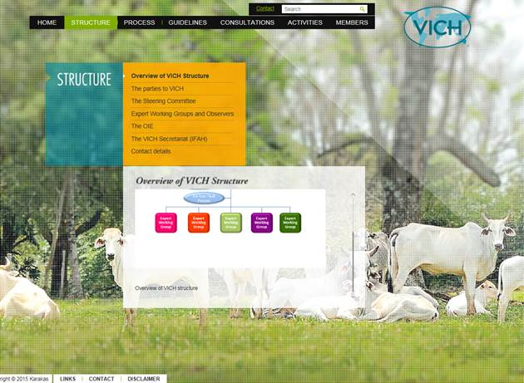
STRUCTURE

Slide 5
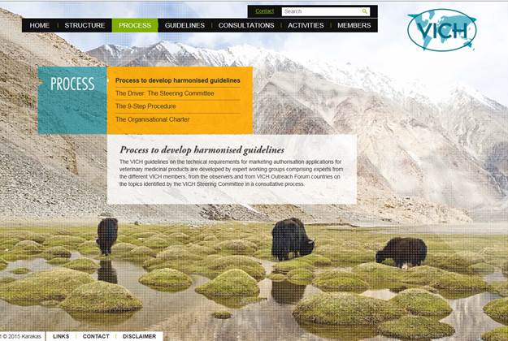
PROCESS

Slide 6
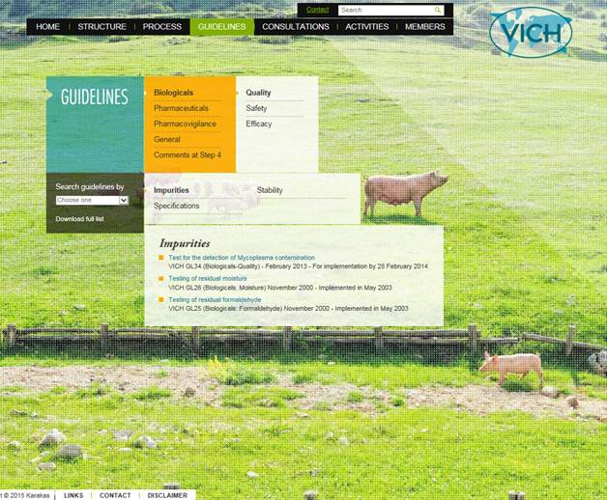
GUIDELINES

Slide 7
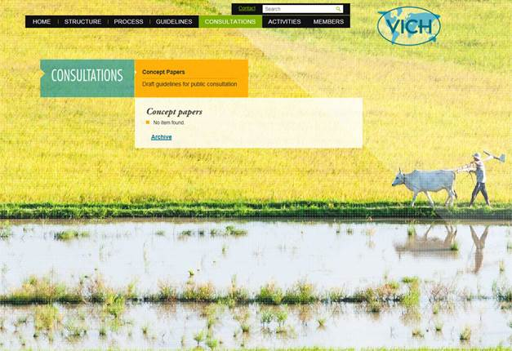
CONSULTATIONS

Slide 8
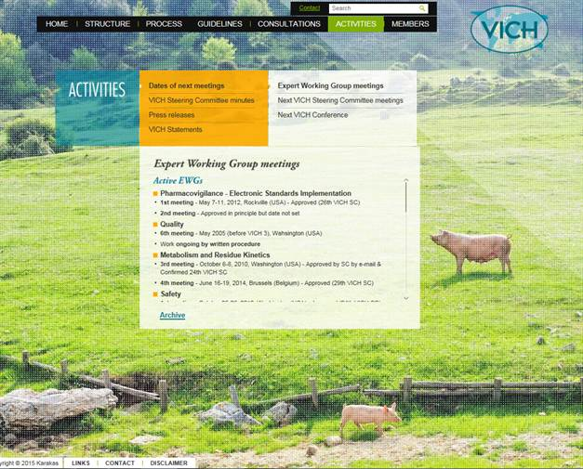
ACTIVITIES

Slide 9

5th VICH Public Conference
October 27 – 29, 2015
Tokyo

Slide 10
5th VICH Public Conference, Tokyo
Contribution of VICH to One Health
Benefits of VICH to emerging economies
Legal framework of VMP regulations and GLs
Contribution of VICH to animal welfare
Voices of industries
Vision for the future

Slide 11


CONFERENCE DETAILS

